Slide 1
Decision Tree on
the implementation of ISO 9001
Umberto Salviati

Slide 2
What is ISO 9001?
ISO:International Organization for Standardization.
ISO 9001 is an international standard for Quality Management Systems (QMS).
It provides a framework for organizations to consistently meet customer needs and regulatory requirements.
ISO 9001 is one of the most widely recognized and adopted ISO standards globally.
ISO 9001 focuses on continuous improvement and customer satisfaction.
It helps organizations enhance their processes, products, and services.

Slide 3

Why ISO as the Domain?
ISO 9001 is a well-established international standard.
It provides a structured framework for quality management.
ISO 9001 consists of a comprehensive list of requirements.
These requirements cover various aspects of quality management.
ISO 9001 involves a multitude of decisions.
Organizations must make decisions regarding processes, documentation, and compliance.
It encourages systematic decision-making.
ISO 9001 promotes a methodical approach to meet customer needs.

Slide 4
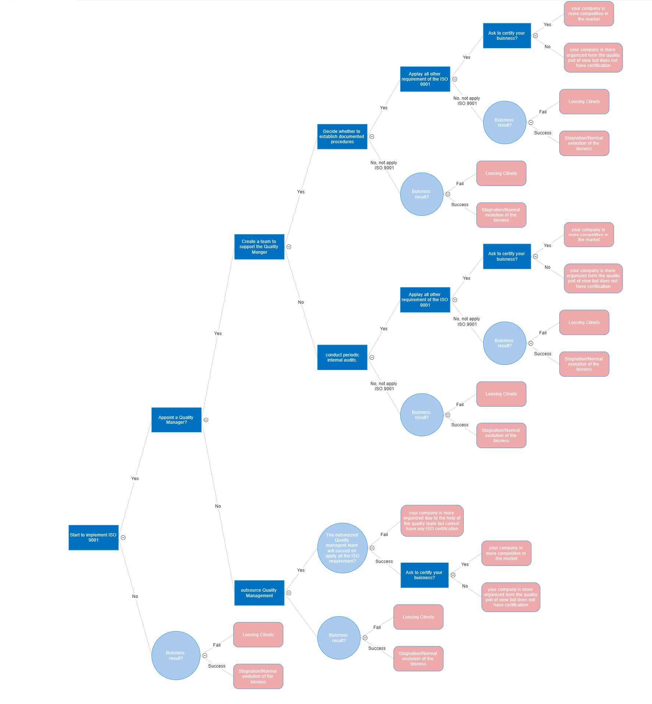
My model
11 decisions
7 uncertain events

